Slide 1
Chemistry Review: Inorganic Components of The Cell
Lecture 3

Slide 2
Objectives
Understand/know/focus on/note
what the inorganic components of the body are & fluid compartments
what hydrogen ion concentration is and its relationship to pH
what strong and weak acids and bases are, what a buffer is, and what makes a good buffer
what extremes of pH can occur naturally in cell physiology
what extremes of pH can indicate a disorder: alkalosis or acidosis

Slide 3
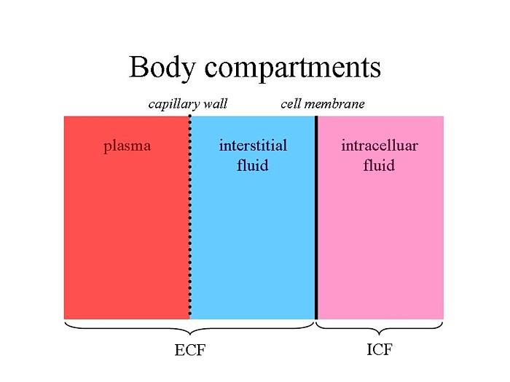
Division of Body Water
http://www.infobarrel.com/media/image/100142_max.jpg

Slide 4
Inorganic Components
Water
Discussed as an important medium (making up 4/5th of cell mass)
Acids & Bases & Salt forms
phosphates, carbonates
Metals and Nonmetal ions
alkaline: Na, K
alkaline earth: Ca, Mg
transition: Fe, Cu, Zn, Mn, Mo

Slide 5
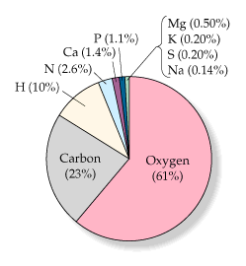
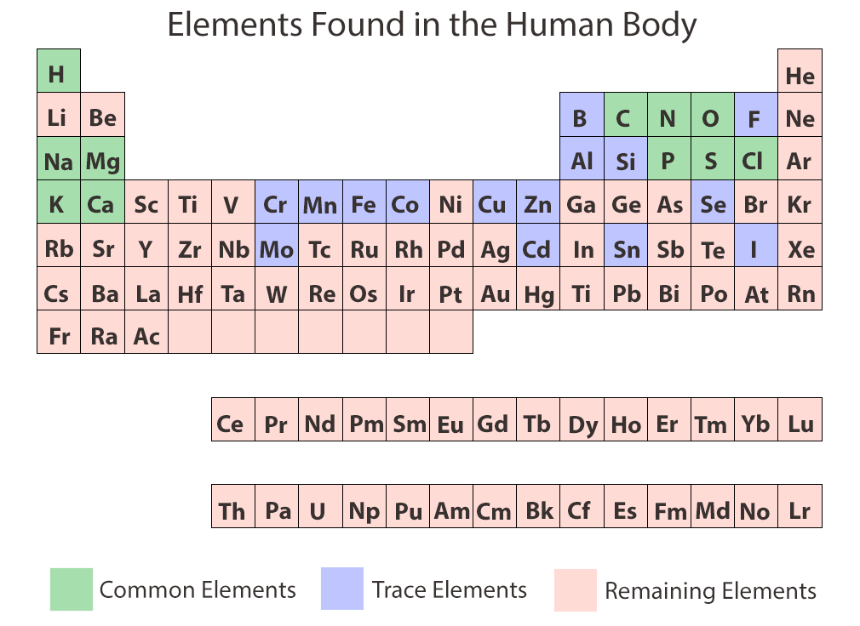
Percentage of elements in human body

Slide 6
Hydrogen Ion Concentration
In aqueous solutions (including cytoplasm of cells), the hydrogen ion concentration [H⁺] is important since it can affect biochemical reactions
Water is a weak acid (acids donate protons H⁺)
It is also a base (bases accept protons)
Water can donate protons to itself:
H₂O + H₂O ←→ H₃O⁺ + OH–
←→ is supposed to mean that there is a forward and reverse reaction
The reaction is often shown as this H₂O ←→ H⁺ + OH–
In pure water, the H⁺ concentration reaches 10^{–7} moles per liter = 10^{–7} molar = 10^{–7} M
This also implies that the [OH–] = 10^{–7} M

Slide 7

K_{w} & pH
An equilibrium constant K is a quotient: it is the arithmetic product of the concentrations of all products divided the arithmetic product of the concentrations of all reactants
$$K=\frac{\left[\text{product}1\right]\left[\text{product}\text{2}\right]…[\text{product}n]}{\left[\text{reactant}1\right]\left[\text{reactant}2\right]…[\text{reactant}n]}$$
The equilibrium constant for water dissociation is K_{w},:
K_{w} = [H⁺][OH–] = [10^{–7}][10^{–7}] = 10^{–14}
those concentrations came from the previous slide
Definition: pH = –log[H⁺]
for pure water: pH = –log 10^{–7} = 7

Slide 8
Mineral Acid
Hydrochloric acid (HCl) is an example of a strong acid
whenever any uses term "mineral" acid, they imply strong acid
Strong acids when added to water completely react with water molecules (which act as bases) to form hydronium ions (H₃O⁺)
HCl + H₂O → H₃O⁺ + Cl–
Most chemists just leave out the fact that a proton (H⁺) is transferred to an accepting base (H₂O) and write:
HCl → H⁺ + Cl–

Slide 9
Mineral Acid
If we add 1 mole HCl to 1 liter H₂O, all of the protons in HCl contribute to the [H⁺] concentration (100% ionization)
So we have [H⁺] = 1 M, and so the pH = –log 1 = 0
If we added 0.001 mole to 1 L water, then
[H+] = 0.001 M, so pH = –log 0.001 = 3

Slide 10
Mineral Bases
Sodium hydroxide (NaOH) is an example of a strong (mineral) base
It produces OH– ions immediately, lowering the [H⁺]
As OH– and H⁺ are in an equilibrium with H₂O and affected by its equilibrium constant K_{w}
Suppose we add 1 mol NaOH to 1 L H₂O, which produces [OH–] = 1 M. What is the [H⁺] and pH?
K_{w} = 10^{–14} = [H⁺] [OH–]
the math says [H⁺] = 10^{–14} M, so pH = 14
Now suppose we prepare 0.001 M NaOH. The math says [H+] = 10^{–11} M, so pH = 11

Slide 11
Weak Acids & Bases
Unlike HCl, weak acids do not completely give up their protons
Acetic acid (CH₃COOH) is an example of a weak acid: when added to water, not all of it ionizes (gives H⁺ to the solution)
Unlike NaOH, weak bases do not completely take up protons in solution
Ammonia (NH₃) is an example of a weak base

Slide 12
Buffers
HA ←→ H⁺ + A–
if HA = HCl, then [HA] = 0 (no HA left)
if HA = CH3COOH, there is much HA remaining
B + H⁺ ←→ BH⁺
if B = NaOH, then [B] = 0 (no NaOH left)
if B = NH3, there is much B remaining
If you add HCl to just water, you get a change in pH that is dependent just on the H⁺ produced by HCl
But if you add HCl to water containing a high concentration of CH₃COOH, the H⁺ resists changing because of the weak acid present
This makes weak acids and bases good buffers.
A buffer is a chemical that resists a change in pH when lots of H+ or OH– ions are produced

Slide 13
Buffering in the Body
The pH of all body fluids, inside and outside of the cells, must be maintained in a narrow range or else enzymes stop doing metabolism
Cytosolic pH values should be between 7.1-7.4 Phosphate (H₂PO4–, HPO₄^{2–}) optimally buffers at pH 7.2, and along with proteins, keeps intracellular pH stable
Blood is buffered using the equilibrium between bicarbonate and carbon dioxide
HCO₃– + H⁺ ⬅➔ H₂CO₃ ⬅➔ H₂O + CO₂
The left side ions HCO₃– and H⁺ are dissolved forms in the blood, while the CO₂ is a gas that forms in the lungs (to be exhaled)

Slide 14
Acidosis & Alkalosis
Normal cell metabolism produces acids that can lower pH. Proper kidney and lung function ensures there is no acid increase (metabolic acidosis)
Hyperventilation causes exhalation of CO₂ in excessive quantities and respiratory alkalosis
this pulls the equilibrium reaction shown on the previous slide to the right, causing a depletion of the H⁺ ion in the blood, thus increasing the pH and leading to alkalosis

Slide 15
Physiological Extremes of pH
Extremes of pH can be generated quite naturally
Within cells: membrane-bound lysosomes particularly within phagocytic immune cells (neutrophils) will produce an internal pH of about 2: shown by enzymes that work in the lysosome having a maximal activity at that low pH
At organ/system level: it is well known that parietal cells in the stomach are engines that pump H⁺ into the gastric fluid for digestion, and that enzymes like pepsin have maximal activity at these low pH values

Slide 16
Reading (Sources)
Becker's WotC: Chapter 2
Raven: Chap 2
Marieb: pp 40-42

